Slide 1


ELECTVIZ
ELECTION DATA VISUALIZATION FOR MEDIA
PRESENTED BY TEAM C
GEETHIKA SUNIL
JANHAVI SHARMA
OMKAR DONGARE
ASHUTOSH JHA

Slide 2

PROJECT OBJECTIVE
Integrate multi-election historical datasets
Standardize and clean public election data
Design star schema data model
Develop interactive dashboards for media analysis
Enable real-time and historical election insights
Support data-driven reporting and broadcast visualization

Slide 3

PROJECT DESCRIPTION
The system:
Imports multi-year Lok Sabha and Vidhan Sabha datasets
Cleans and standardizes state, constituency, party, and candidate data
Creates interactive dashboards with filtering and drill-down
Simulates real-time election result updates
Enables visualization of vote share, turnout and party performance.

Slide 4

MILESTONE 1
Historical data from multiple elections imported and cleaned
Star schema created with valid relationships
Candidates
Votes
Constituencies
Parties

Slide 5

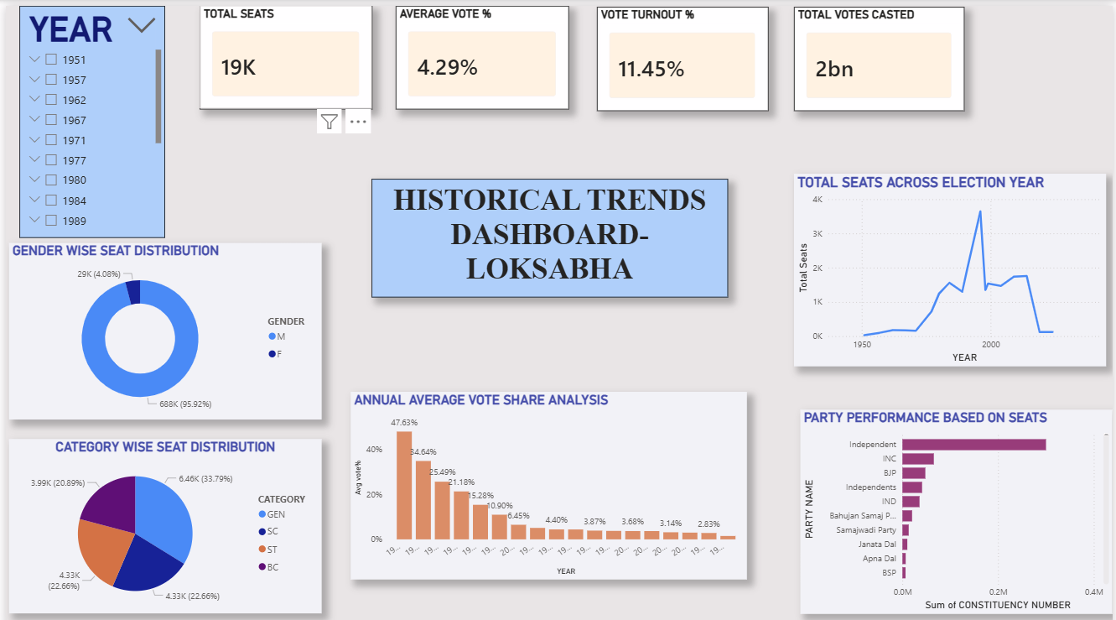
MILESTONE 2
HISTORICAL TRENDS DASHBOARD-LOKSABHA

Slide 6
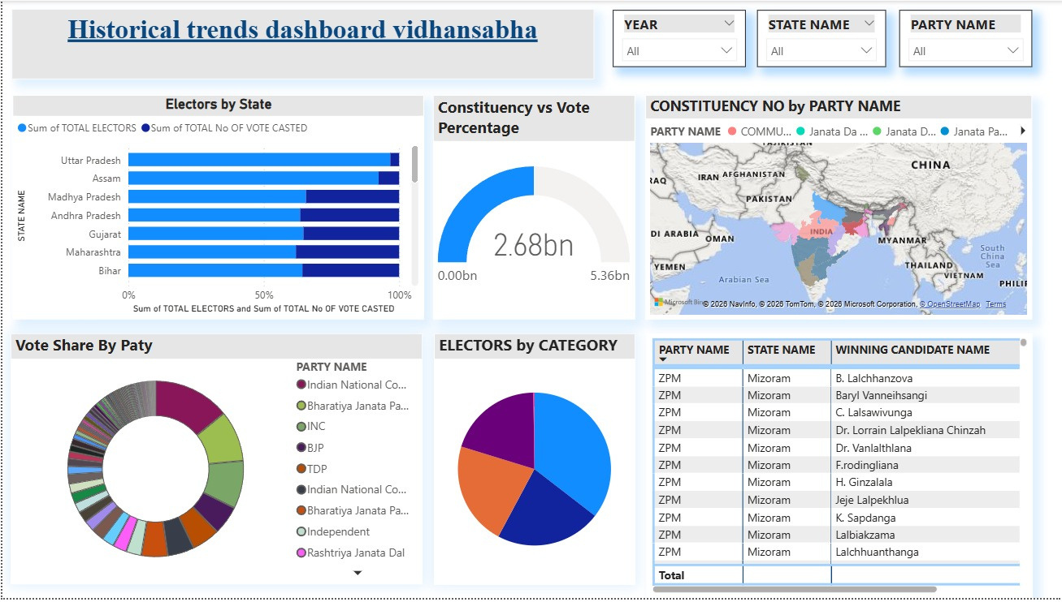
HISTORICAL TRENDS DASHBOARD-VIDHANSABHA

Slide 7

HISTORICAL TRENDS DASHBOARD
Vote Share Dashboard completed
Turnout Dashboard completed
Filter functionality enabled
Year
Party
State

Slide 8
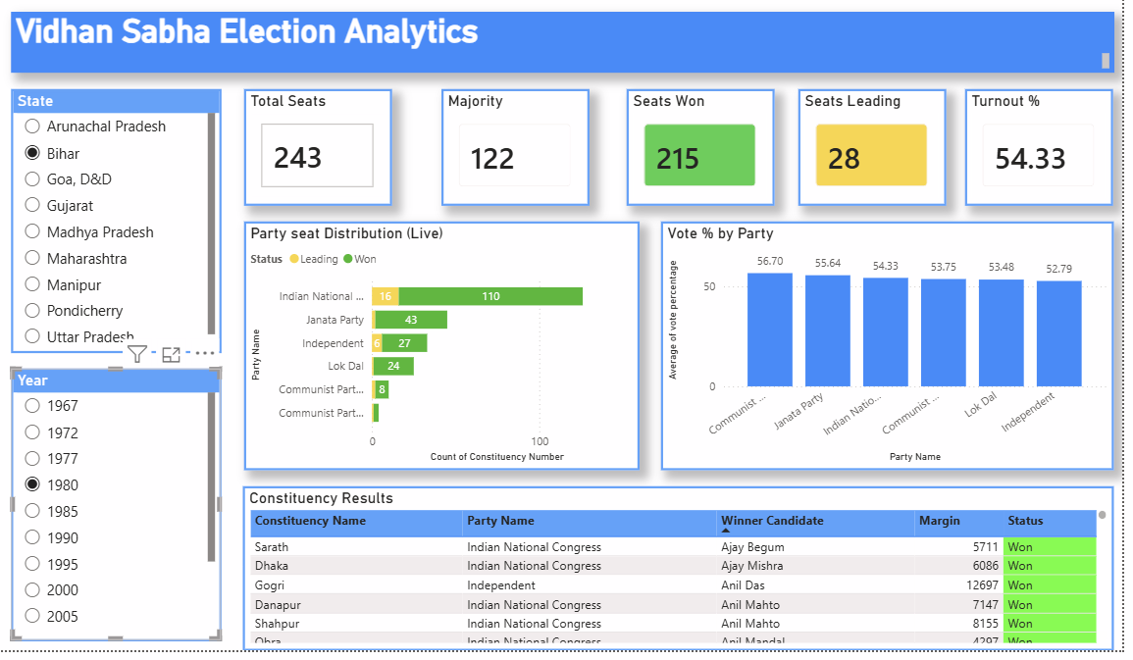
MILESTONE 3
REAL TIME RESULTS DASHBOARD

Slide 9

KEY INSIGHTS
Current leading party and seat distribution.
Narrow margins in competitive constituencies.
Regional dominance patterns.
Vote percentage gap between major parties.
Trend comparison with previous elections.

Slide 10

MILESTONE 4
Turnouts & Demographic Analysis
Scope of Model: Analyze voter turnout patterns across states and demographics.
Objective: Understand how demographic factors influence voter participation.
Level of Analysis: State and constituency-level comparison with urban–rural segmentation
.
Key Features: Interactive filtering by year, state, gender, and region.
Visualization: Bar charts, pie charts, and heatmaps for turnout distribution.
Insights: Identifies regions and demographics with high or low voter engagement.

Slide 11
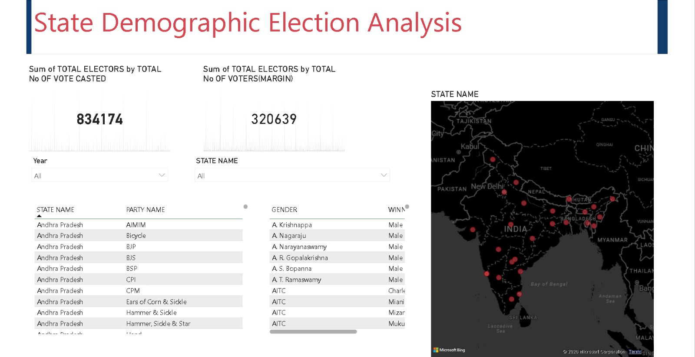
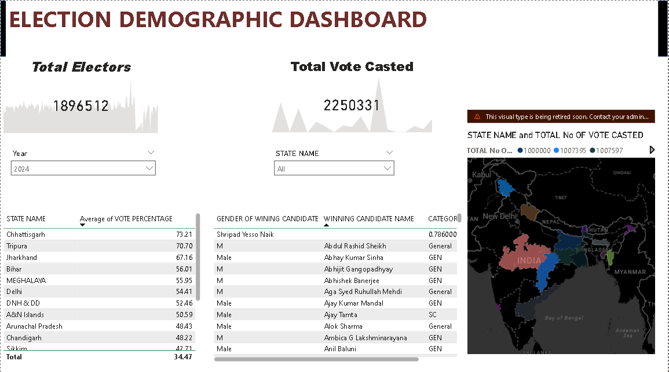
DEMOGRAPHICS DASHBOARD
11

Slide 12

MILESTONE 5
PARTY AND CANDIDATE PERFORMANCE ANALYSIS
Analyzes party-wise seat share and vote percentage across elections
Compares performance of different parties over multiple years
Evaluates candidate win/loss margins and re-election trends
Identifies top-performing candidates and competitive constituencies
Provides drill-down analysis at state and constituency levels

Slide 13
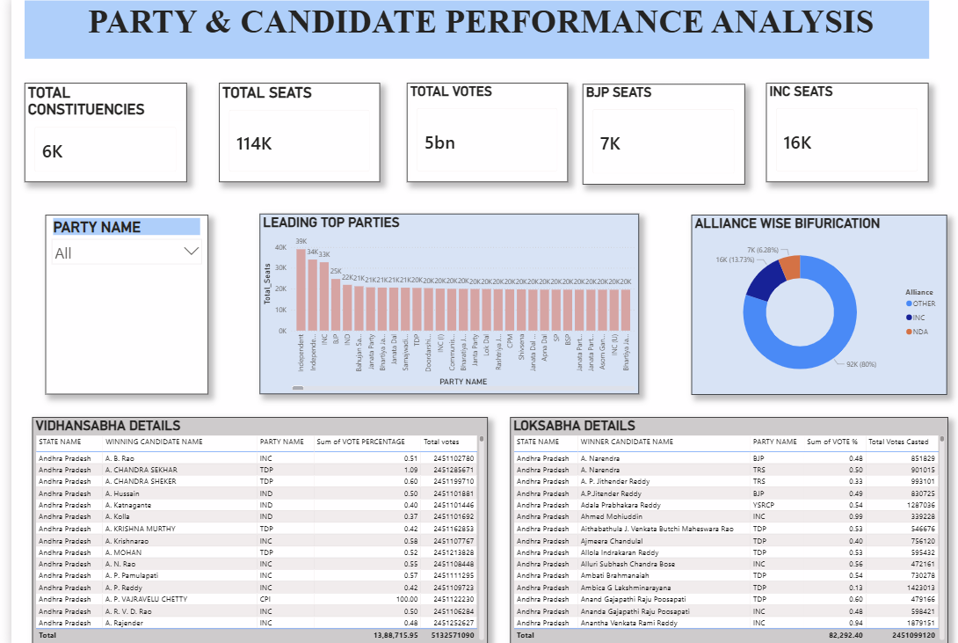

Slide 14

PROJECT EXECUTION DETAILS
The project execution included:
Multi-source election dataset integration
Data cleaning and transformation using Power Query
DAX measures for:
Vote %
Seat Share
Turnout %
Dashboard development in Power BI
Interactive filtering and drill-through configuration

Slide 15
CHALLENGES FACED
Inconsistent state-wise dataset formats
Large volume of multi-year data
Standardizing party and constituency names
Creating accurate DAX measures
Optimizing dashboard performance

Slide 16
CONCLUSION
Successfully integrated and standardized multi-state election datasets.
Developed interactive Power BI dashboards for historical, real-time, and demographic analysis.
Enabled clear visualization of party performance, voter turnout, and electoral trends.
Provided data-driven insights to support news reporting and analytical decision-making.

